Slide 1
Science of Team Science A Concept Mapping Project
William M. Trochim
Presentation to First Annual Conference on the Science of Team Science
Northwestern University, Chicago, IL
Thursday, April 22, 2010
This presentation contains draft results from studies that are still in progress. It may not be reproduced or distributed without written permission from the author.

Slide 2
Project Goals
Develop a “roadmap” of a comprehensive research agenda for the science of team science
Help orient participants during the conference
Provide a framework that can help inform the field
Use a team science approach to mapping team science
Structured concept mapping
Integrative mixed methods approach
Integrates group process with statistical analysis
Utilizes web technology for distributed participation
Provides a rigorous visually interpretable result

Slide 3
Define the Focus
Develop a focus
“One topic that should be part of a comprehensive research agenda for the science of team science is…”

Slide 4
Identify Participants
Develop a focus
Identify the participants
All conference invitees were asked to Brainstorm & Rate
- 63 Rated
15 steering committee members sorted
“One topic that should be part of a comprehensive research agenda for the science of team science is…”

Slide 5
Brainstorm Outcomes
Develop a focus
Identify the participants
Generate Ideas
89 using publication and bibliometric data (e.g., citation rates, impact factors) to assess team science
69 importance of developing multi-method strategies to assess processes and outcomes of team science
2 how to evaluate success of team science-based research centers
65 measuring effectiveness of team science on multiple levels: individual team, impact of research, effectiveness of team science funding programs, etc.
240
95

Slide 6
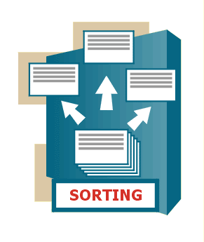
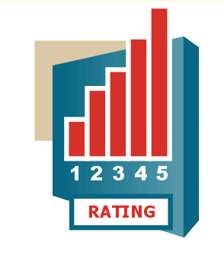
Organize Outcomes
Develop a focus
Identify the participants
Generate Ideas
Structure Ideas
Sort the ideas
Rate the ideas
Importance

Slide 7
Compute Maps
Develop a focus
Identify the participants
Generate Ideas
Structure Ideas
77
42
43
53
Compute Maps
Aggregate sorts
Multidimensional scaling
Hierarchical cluster analysis
24
73
36
21
76
104
20
23
55
8
110
74
32
108
75
6
22
70
105
37
109
79
71
7
33
106
112
47
48
26
27
101
46
94
39
9
34
107
54
49
52
99
88
25
3
45
8
5
78
38
115
51
14
15
16
95
28
11
12
13
50
40
68
111
10
116
103
92
90
3
18
84
6
7
100
91
114
2
93
1
1
81
4
17
113
64
82
86
41
63
2
102
5
69
61
19
57
4
44
62
58
65
56
96
98
60
35
89
80
67
87
83
66
29
72
31
59
117
97
30
85

Slide 8
Interpret Maps
Develop a focus
Identify the participants
Generate Ideas
42
53
77
43
Structure Ideas
24
73
36
21
76
104
20
23
55
8
110
74
32
108
79
6
22
37
109
75
71
70
7
33
105
106
112
47
26
27
101
46
48
94
39
9
99
34
107
54
45
49
8
52
5
88
78
25
3
Compute Maps
51
38
115
14
15
16
95
28
11
12
13
50
40
68
111
10
116
103
92
90
3
7
18
84
6
100
91
114
Interpret Maps
64
2
93
1
1
81
4
17
113
82
86
41
63
2
102
5
69
61
19
57
4
44
62
58
65
96
98
60
35
89
56
87
83
66
29
80
67
72
31
59
117
97
30
85

Slide 9
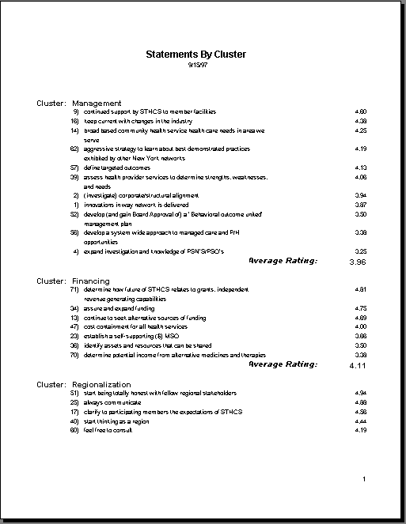
Use Maps
Develop a focus
Identify the participants
Generate Ideas
Structure Ideas
Area 1
Area 2
4.22
4.4
Mission & Ideology
Mission & Ideology
Financing
Financing
Compute Maps
Regionalization
Technology
Management
Regionalization
Information Services
Information Services
Community & Consumer Views
Management
Interpret Maps
Technology
Community & Consumer Views
3.47
r = .51
3.56
Utilize Maps
Provide initial roadmap for conference and the field

Slide 10
Who participated?

Slide 11
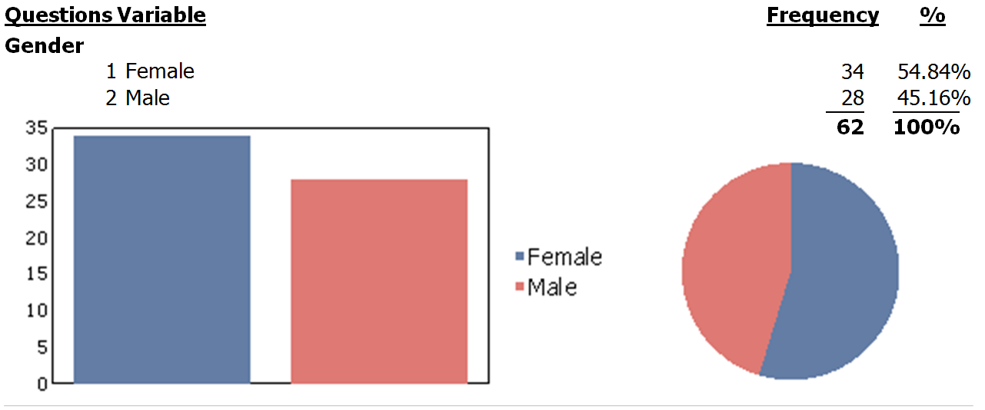
Gender

Slide 12
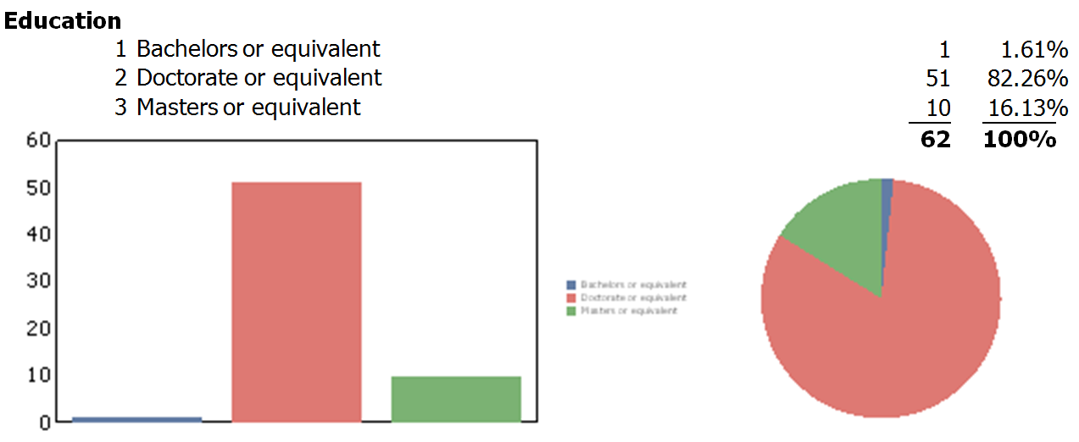
Education

Slide 13
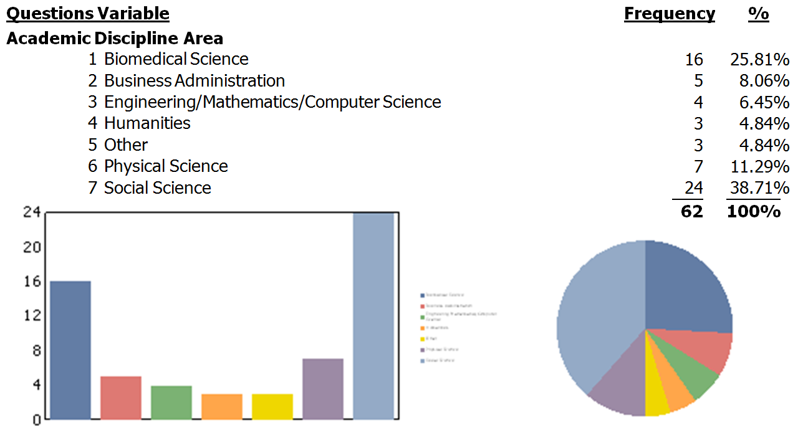
Academic Discipline

Slide 14
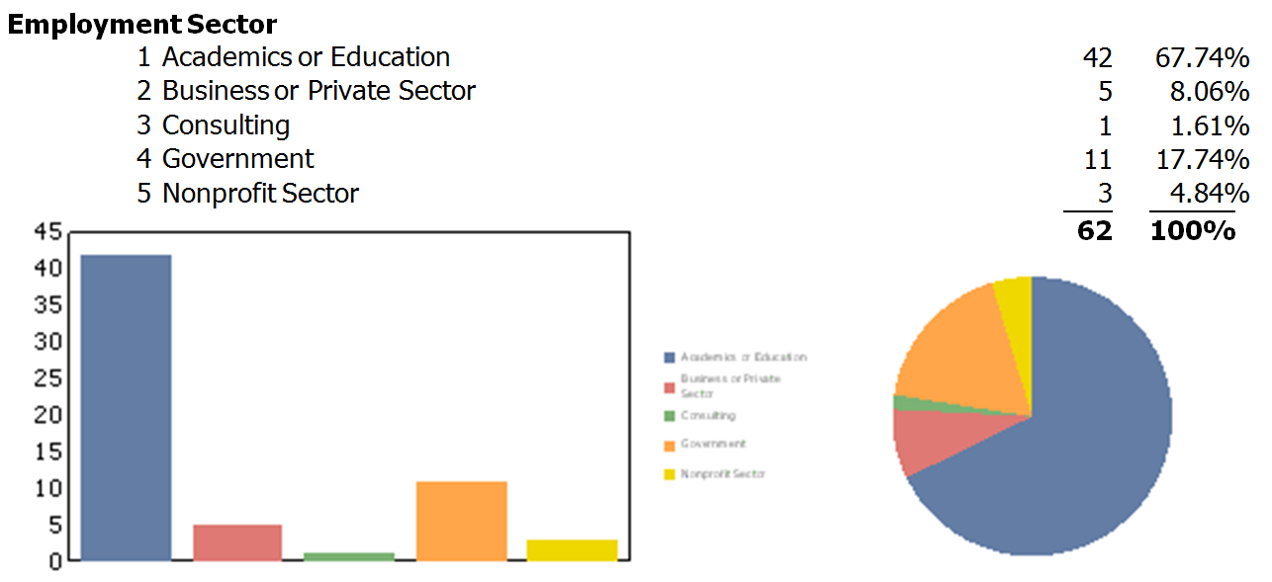
Employment

Slide 15
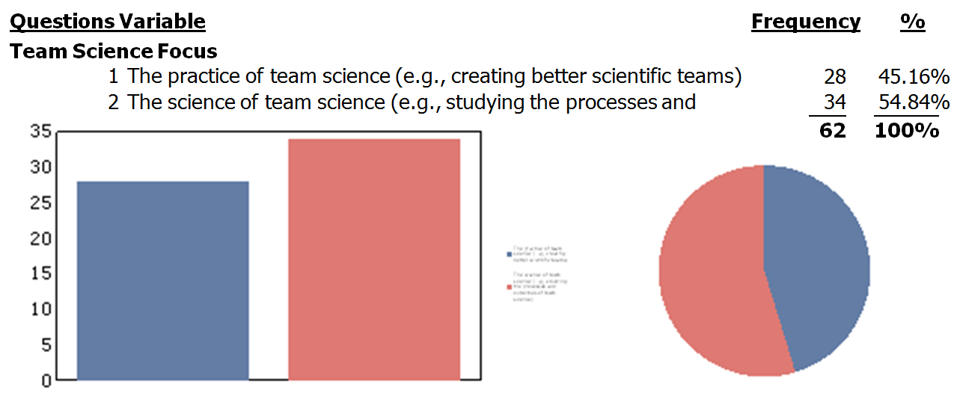
Team Science Focus

Slide 16
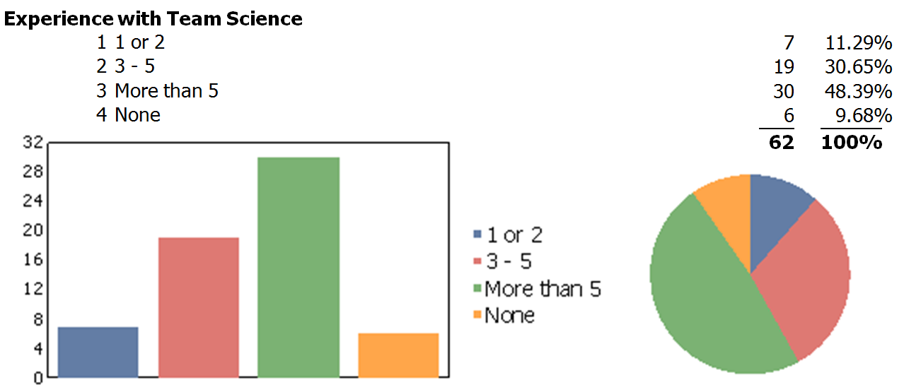
Experience with Team Science

Slide 17
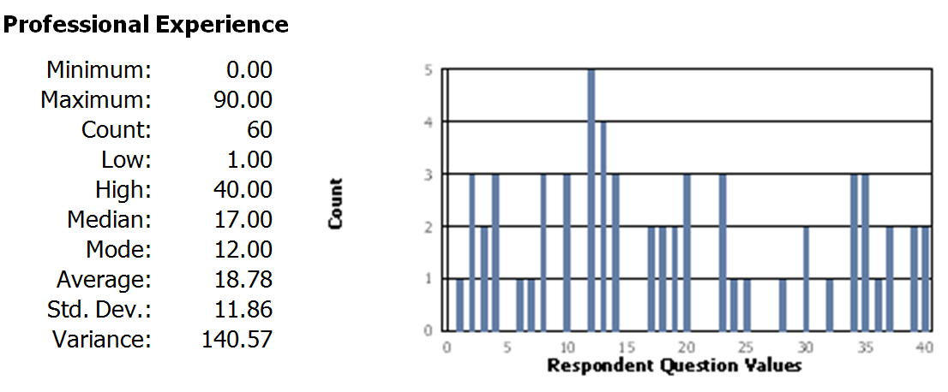
Professional Experience

Slide 18
How did we obtain the results?

Slide 19
This initial map shows all the potential outcomes in relation to one another
77
83
17
69
89
32
65
8
2
73
88
58
62
46
50
13
72
4
79
63
29
18
3
52
15
45
64
22
10
28
57
33
30
67
7
56
36
11
59
82
37
54
53
42
19
38
14
12
85
41
9
20
92
55
70
75
40
51
74
86
34
78
24
68
90
5
80
31
35
49
95
81
25
23
39
66
47
26
87
93
48
94
84
91
60
16
1
61
76
21
6
44
43
27
71

Slide 20
Each point represents one of the brainstormed outcomes
77
83
17
69
89
32
65
8
2
73
88
58
62
46
50
13
72
4
79
63
29
18
3
52
15
45
64
22
10
28
57
33
30
67
7
56
36
11
59
82
37
54
53
42
19
38
14
12
85
41
9
20
92
55
70
75
40
51
74
86
34
78
24
68
90
5
80
31
35
49
95
81
25
23
39
66
47
26
87
93
48
94
84
91
60
16
1
61
76
21
6
44
43
27
71
6 heterogeneity of team membership

Slide 21
Conceptually similar outcomes are in close proximity
77
83
17
69
89
32
65
8
2
73
88
58
62
46
50
13
72
4
79
63
29
18
3
52
15
45
64
22
10
28
57
33
30
67
7
56
36
11
59
82
37
54
53
42
19
38
14
12
85
41
9
20
92
55
70
75
40
51
74
86
34
78
24
68
90
5
80
31
35
49
95
81
25
23
39
66
47
26
87
93
48
94
84
91
60
16
1
61
76
21
6
44
43
27
71
6 heterogeneity of team membership
91 status differences and power dynamics within the team
44 team member interchangeability

Slide 22
Conceptually different outcomes are further apart
83
58 evaluating and learning from successful teams
77
17
69
89
32
65
8
2
73
88
58
62
46
50
13
72
4
79
63
29
18
3
52
15
45
64
22
10
28
57
33
30
67
7
56
36
11
59
82
37
54
53
42
19
38
14
12
85
41
9
20
92
55
70
75
40
51
74
86
34
78
24
68
90
5
80
31
35
49
95
81
25
23
39
66
47
26
87
93
48
94
84
91
60
16
1
61
76
21
6
44
81 co-authorship and multi-PI authorship in team science
90 use of collaborative computerized tools to support and enhance team science
43
27
71
6 heterogeneity of team membership
91 status differences and power dynamics within the team
44 team member interchangeability

Slide 23
The outcomes are organized into clusters
77
83
17
69
89
32
65
8
2
73
88
58
62
46
50
13
72
4
79
63
29
18
3
52
15
45
64
22
10
28
57
33
30
67
7
56
36
11
59
82
37
54
53
42
19
38
14
12
85
41
9
20
92
55
70
75
40
51
74
86
34
78
24
68
90
5
80
31
35
49
95
81
25
23
39
66
47
26
87
93
48
94
84
91
60
16
1
61
76
21
6
44
43
27
71
This map shows each of 95 statements grouped into seven clusters by hierarchical cluster analysis.

Slide 24
The Map Results

Slide 25
Measurement & Evaluation of Team Science
77
83
17
69
89
32
65
8
2
88
58
46
50
13
4
79
63
29
18
3
52
64
22
89 using publication and bibliometric data (e.g., citation rates, impact factors) to assess team science
69 importance of developing multi-method strategies to assess processes and outcomes of team science
2 how to evaluate success of team science-based research centers
65 measuring effectiveness of team science on multiple levels: individual team, impact of research, effectiveness of team science funding programs, etc.
8 measurement of key constructs (e.g., collaboration, disciplinarity, team effectiveness, personal/behavioral characteristics, team processes, readiness; synergy, productivity, shared knowledge)
46 best approach(es) to assessing scientific teams within an institution
17 research on methodology and measurement of team science
13 evaluation of team science and its impacts
58 evaluating and learning from successful teams
50 how to measure an increase in team science activity and collaboration at an institution, in comparison with other institutions
83 how to evaluate existing and new tools
63 how network information can provide insight into performance and evaluation of teams
88 key performance indicators to encourage team science evaluation into individual development and professional growth
3 comparing the effects of team science versus traditional science in advancing scientific knowledge
79 infrastructures to capture relevant data to better assess team science outcomes
52 to assess whether the findings produced by team science are more broadly disseminated, as compared to traditional science
18 social network analysis of scientific teams
77 strengthening the research methods for studying scientific teams (e.g., using quasi-experimental methods)
32 how to use team science approaches and methods in the investigation of team science
29 economic value created by team science
4 how to demonstrate an effective team in a grant proposal
64 the availability of organizational structure data as a data source
22 approaches for capturing the expertise of team science leaders

Slide 26
Structure & Context for Teams
41 whether collaborative spaces for team science encourage collaboration
54 use and impact of community-based organizations and community clinical practices in teams
70 what types of team organizations are best at facilitating team science
42 the impact of team size on process and outcomes in team science
11 the effects of the type and complexity of research question on team science
40 how research networking tools can enhance team science
9 the relationship between productivity and the composition of teams
67 the effect of research centers in promoting a team science approach
20 the relationships among creativity, innovation and the composition of teams
53 contextual/situational factors that influence the effectiveness of team collaboration
30 keys for success in team science
56 effects of sustained, hard team work
7 status of the team as it appears to external individuals and groups
28 a study of team science outcomes with junior versus senior Pis
14 how the changing ecology and structure of teams influence future scientific collaborations
37 the network characteristics of productive science team members and subgroups
57 how team dynamics can impact science
30
28
57
67
7
56
11
37
54
53
42
41
14
20
70
9
40

Slide 27
Characteristics & Dynamics of Teams
91 status differences and power dynamics within the team
44 team member interchangeability
21 how roles in teams are defined and communicated, and by whom
26 the influence of research team morale
60 personal and behavioral factors in team science collaborations
94 different types of conflicts that occur in scientific teams and how to address these effectively
23 communication styles in teams
84 leadership characteristics that drive effective team science
68 optimal team composition (e.g., specialists, generalists, boundary spanners) to enable use of diverse expertise.
87 social skills and competencies required for successful team science
27 the psychological and personality factors associated with being an effective team scientist
47 team member physical proximity (co-location)
24 ideal composition of scientific teams
6 heterogeneity of team membership
39 how teams grow, shrink, expire over time
48 issues to consider when initiating or building a new team
43 collaborative readiness factors
49 finding potential/likely research collaborators
34 what factors contribute to the development of trust in different collaborations
95 why people join teams
51 gender differences in team contributions
51
34
24
68
49
95
23
26
39
87
47
94
84
60
48
21
91
6
44
43
27

Slide 28
Management & Organization for Teams
76 value of rotating team leadership
93 the management of scientific teams
78 how to sustain scientific teams
61 membership in multiple, potentially overlapping, potentially conflicting teams
35 organizational policies that foster team science
66 virtual organizations and team science
86 formal vs. informal organizational structures of institutions
1 types of organizational structures of team science
71 disciplinary language barriers in team science
86
78
35
66
93
1
61
76
71

Slide 29
Institutional Support & Professional Development for Teams
31 incentives and incentive systems for team science
74 resources and infrastructure needed within and across institutions to promote collaboration and team science
25 how the university tenure and promotion system can be restructured to encourage team science
80 processes and methods that encourage and support teams (e.g., group activities, scientific conferences, grant opportunity distribution, systems-based approaches
85 relationships between team science in the academy and industry
55 timing, with regards to investigator career stage, in team science
92 ethical issues in conducting team science (e.g. intellectual property ownership, defining collaborative relationships; attributing credit for work)
5 training and education issues in team science
75 funding to support the science of team science, research on team science
81 co-authorship and multi-PI authorship in team science
12 the effects of team science on the scientist's work and career
90 use of collaborative computerized tools to support and enhance team science
16 individual benefit/risk analysis to engaging in team science
12
85
92
75
74
90
5
80
31
81
25
16

Slide 30
Disciplinary Dynamics & Team Science
82 variations in team science related to disciplinarity
38 how to overcome disciplinary traditions to move toward interdisciplinary traditions
59 using team science and interdisciplinary research to support emerging areas of science
36 applying what is known about teams in different disciplines (e.g., management) and contexts (e.g., international)
33 relationships and connections between multi-, inter- and transdisciplinary research efforts and team science
19 how best to disseminate findings and best practices from the science of team science
10 understanding differences between intra- vs. interinstitutional scientific teams
10
33
36
59
82
19
38

Slide 31
Definitions & Models of Team Science
62
73
72
15
45
72 theories and models of team science
45 best practices of team science
73 developing testable hypotheses about team science
62 the definitions of team, scientific team, and team science
15 definition of different types of disciplinarity (interdisciplinary; multidisciplinarity; transdisciplinarity)

Slide 32
Cluster Map
Definitions & Models of Team Science
Measurement & Evaluation of Team Science
Disciplinary Dynamics & Team Science
Structure & Context for Teams
Institutional Support & Professional Development for Teams
Characteristics & Dynamics of Teams
Management & Organization for Teams

Slide 33
Regional Interpretation
Meta-Issues
Definitions & Models of Team Science
Measurement & Evaluation of Team Science
The Team
Disciplinary Dynamics & Team Science
Structure & Context for Teams
Institutional Support & Professional Development for Teams
Nuts & Bolts
Characteristics & Dynamics of Teams
Management & Organization for Teams
Support

Slide 34
Ratings and Pattern Matches

Slide 35
Importance Point Rating Map
Point Legend
Layer Value
1 2.58 to 2.95
Definitions & Models of Team Science
Measurement & Evaluation of Team Science
2 2.95 to 3.33
83
69
89
3 3.33 to 3.70
77
17
65
2
4 3.70 to 4.07
32
8
58
5 4.07 to 4.44
73
88
62
46
50
13
72
4
79
29
18
63
52
15
3
45
64
22
Structure & Context for Teams
Disciplinary Dynamics & Team Science
10
28
57
33
30
67
7
56
36
11
59
82
37
54
53
42
19
38
14
12
85
41
9
20
92
55
70
75
40
51
74
86
34
78
24
68
90
5
25
80
31
35
49
95
81
66
23
26
39
47
94
84
87
Institutional Support & Professional Development for Teams
93
48
91
60
16
1
61
76
21
6
44
43
27
71
Characteristics & Dynamics of Teams
Management & Organization for Teams

Slide 36
Importance Cluster Rating Map
Definitions & Models of Team Science
Measurement & Evaluation of Team Science
Disciplinary Dynamics & Team Science
Structure & Context for Teams
Institutional Support & Professional Development for Teams
Characteristics & Dynamics of Teams
Management & Organization for Teams
Cluster Legend
Layer Value
1 3.43 to 3.49
2 3.49 to 3.55
3 3.55 to 3.61
4 3.61 to 3.68
5 3.68 to 3.74

Slide 37
Top Ten Statements By Average Importance
8 measurement of key constructs (e.g., collaboration, disciplinarity, team effectiveness, personal/behavioral characteristics, team processes, readiness; synergy, productivity, shared knowledge) (4.44)
30 keys for success in team science (4.23)
13 evaluation of team science and its impacts (4.22)
45 best practices of team science (4.16)
65 measuring effectiveness of team science on multiple levels: individual team, impact of research, effectiveness of team science funding programs, etc. (4.16)
2 how to evaluate success of team science-based research centers (4.14)
35 organizational policies that foster team science (4.13)
9 the relationship between productivity and the composition of teams (4.11)
3 comparing the effects of team science versus traditional science in advancing scientific knowledge (4.08)
74 resources and infrastructure needed within and across institutions to promote collaboration and team science (4.03)

Slide 38
Gender
Female
Male
3.8
3.66
Measurement & Evaluation of Team Science
Measurement & Evaluation of Team Science
Institutional Support & Professional Development for Teams
Definitions & Models of Team Science
Definitions & Models of Team Science
Disciplinary Dynamics & Team Science
Disciplinary Dynamics & Team Science
Structure & Context for Teams
Structure & Context for Teams
Management & Organization for Teams
Management & Organization for Teams
Characteristics & Dynamics of Teams
Characteristics & Dynamics of Teams
Institutional Support & Professional Development for Teams
3.46
3.35
r = .5

Slide 39
Education
Bachelors or Masters
Doctorate
3.7
3.75
Measurement & Evaluation of Team Science
Measurement & Evaluation of Team Science
Institutional Support & Professional Development for Teams
Definitions & Models of Team Science
Disciplinary Dynamics & Team Science
Disciplinary Dynamics & Team Science
Structure & Context for Teams
Structure & Context for Teams
Management & Organization for Teams
Institutional Support & Professional Development for Teams
Characteristics & Dynamics of Teams
Management & Organization for Teams
Definitions & Models of Team Science
Characteristics & Dynamics of Teams
3.18
3.47
r = .25

Slide 40
Professional Experience
Below Median
Above Median
3.85
3.61
Measurement & Evaluation of Team Science
Measurement & Evaluation of Team Science
Disciplinary Dynamics & Team Science
Definitions & Models of Team Science
Definitions & Models of Team Science
Structure & Context for Teams
Institutional Support & Professional Development for Teams
Institutional Support & Professional Development for Teams
Management & Organization for Teams
Disciplinary Dynamics & Team Science
Structure & Context for Teams
Management & Organization for Teams
Characteristics & Dynamics of Teams
Characteristics & Dynamics of Teams
3.5
3.33
r = .7

Slide 41
Employment Sector
Academics
Government
3.8
3.67
Measurement & Evaluation of Team Science
Measurement & Evaluation of Team Science
Definitions & Models of Team Science
Definitions & Models of Team Science
Institutional Support & Professional Development for Teams
Structure & Context for Teams
Disciplinary Dynamics & Team Science
Disciplinary Dynamics & Team Science
Management & Organization for Teams
Institutional Support & Professional Development for Teams
Structure & Context for Teams
Management & Organization for Teams
Characteristics & Dynamics of Teams
Characteristics & Dynamics of Teams
3.55
3.27
r = .69

Slide 42
Team Science Focus
Practice
Science
3.73
3.82
Measurement & Evaluation of Team Science
Definitions & Models of Team Science
Institutional Support & Professional Development for Teams
Measurement & Evaluation of Team Science
Structure & Context for Teams
Disciplinary Dynamics & Team Science
Management & Organization for Teams
Structure & Context for Teams
Disciplinary Dynamics & Team Science
Management & Organization for Teams
Characteristics & Dynamics of Teams
Institutional Support & Professional Development for Teams
Definitions & Models of Team Science
Characteristics & Dynamics of Teams
3.41
3.4
r = -.08

Slide 43
Experience with Teams
None
1 or 2
3 - 5
More Than 5
3.67
4
3.67
3.77
Characteristics & Dynamics of Teams
Measurement & Evaluation of Team Science
Management & Organization for Teams
Definitions & Models of Team Science
Definitions & Models of Team Science
Institutional Support & Professional Development for Teams
Measurement & Evaluation of Team Science
Structure & Context for Teams
Structure & Context for Teams
Disciplinary Dynamics & Team Science
Institutional Support & Professional Development for Teams
Management & Organization for Teams
Disciplinary Dynamics & Team Science
Characteristics & Dynamics of Teams
3.45
3.28
3.41
3.42
r = -.8
r = .43
r = .8

Slide 44
Academic Discipline
Biomedical
Social
Physical
Humanities
Engineering/Math
Business Administration
3.96
3.77
3.67
4.47
3.95
3.5
Measurement & Evaluation of Team Science
Measurement & Evaluation of Team Science
Institutional Support & Professional Development for Teams
Institutional Support & Professional Development for Teams
Definitions & Models of Team Science
Management & Organization for Teams
Disciplinary Dynamics & Team Science
Structure & Context for Teams
Structure & Context for Teams
Characteristics & Dynamics of Teams
Characteristics & Dynamics of Teams
Disciplinary Dynamics & Team Science
Management & Organization for Teams
Definitions & Models of Team Science
3.56
3.44
3.23
3.59
2.9
2.64
r = .4
r = .48
r = .2
r = .74
r = -.46

Slide 45
Using the Maps: The Science of Team Science Conference Program

Slide 46
Regional Interpretation
Meta-Issues
Definitions & Models of Team Science
Measurement & Evaluation of Team Science
The Team
Disciplinary Dynamics & Team Science
Structure & Context for Teams
Institutional Support & Professional Development for Teams
Nuts & Bolts
Characteristics & Dynamics of Teams
Management & Organization for Teams
Support

Slide 47
Regional Interpretation - Panel X1
Meta-Issues
Definitions & Models of Team Science
Measurement & Evaluation of Team Science
The Team
Disciplinary Dynamics & Team Science
Structure & Context for Teams
Institutional Support & Professional Development for Teams
Nuts & Bolts
Characteristics & Dynamics of Teams
Management & Organization for Teams
Support

Slide 48
Regional Interpretation – Panel X2
Meta-Issues
Definitions & Models of Team Science
Measurement & Evaluation of Team Science
The Team
Disciplinary Dynamics & Team Science
Structure & Context for Teams
Institutional Support & Professional Development for Teams
Nuts & Bolts
Characteristics & Dynamics of Teams
Management & Organization for Teams
Support

Slide 49
Regional Interpretation – Panel X3
Meta-Issues
Definitions & Models of Team Science
Measurement & Evaluation of Team Science
The Team
Disciplinary Dynamics & Team Science
Structure & Context for Teams
Institutional Support & Professional Development for Teams
Nuts & Bolts
Characteristics & Dynamics of Teams
Management & Organization for Teams
Support

Slide 50
Regional Interpretation - Panel X4
Meta-Issues
Definitions & Models of Team Science
Measurement & Evaluation of Team Science
The Team
Disciplinary Dynamics & Team Science
Structure & Context for Teams
Institutional Support & Professional Development for Teams
Nuts & Bolts
Characteristics & Dynamics of Teams
Management & Organization for Teams
Support

Slide 51
Regional Interpretation - Panel X5
Meta-Issues
Definitions & Models of Team Science
Measurement & Evaluation of Team Science
The Team
Disciplinary Dynamics & Team Science
Structure & Context for Teams
Institutional Support & Professional Development for Teams
Nuts & Bolts
Characteristics & Dynamics of Teams
Management & Organization for Teams
Support

Slide 52
Regional Interpretation - Panel X6
Meta-Issues
Definitions & Models of Team Science
Measurement & Evaluation of Team Science
The Team
Disciplinary Dynamics & Team Science
Structure & Context for Teams
Institutional Support & Professional Development for Teams
Nuts & Bolts
Characteristics & Dynamics of Teams
Management & Organization for Teams
Support

Slide 53
Regional Interpretation - Panel X7
Meta-Issues
Definitions & Models of Team Science
Measurement & Evaluation of Team Science
The Team
Disciplinary Dynamics & Team Science
Structure & Context for Teams
Institutional Support & Professional Development for Teams
Nuts & Bolts
Characteristics & Dynamics of Teams
Management & Organization for Teams
Support

Slide 54
Thanks
The Concept Mapping Steering Committee
Cath Kane
Holly Falk-Krzesinski
Steve Fiore
Dan Stokols
Kara Hall
Bonnie Spring
Noshir Contractor
For more information
www.conceptsystems.com
Bill Trochim: wmt1@cornell.edu

